Slide 1

EARLY FAULT DETECTION IN SOLAR PV SYSTEMS USING MACHINE LEARNING ELECTRICAL ENGINEERING PROJECT EEM-705
Presented By: Ansh Prasad
Tanvi Malik
Supervised By:Prof. G.S. Sailesh Babu

Slide 2
Fault Detection and Optimization in Solar PV Systems
Increasing global reliance on solar photovoltaic (PV) systems for sustainable energy production.
Challenges include energy losses, downtime, and maintenance costs caused by:
Shading, soiling, inverter failures, wiring defects.
Emphasis on the need for reliable fault detection and system optimization.

Slide 3
Limitations of Existing Methods
Traditional Approaches:
Manual inspections.
Basic monitoring systems.
Key Issues:
Inability to detect faults promptly.
Ineffectiveness in dynamic and complex operational conditions.
Prolonged inefficiencies and higher operational costs.

Slide 4
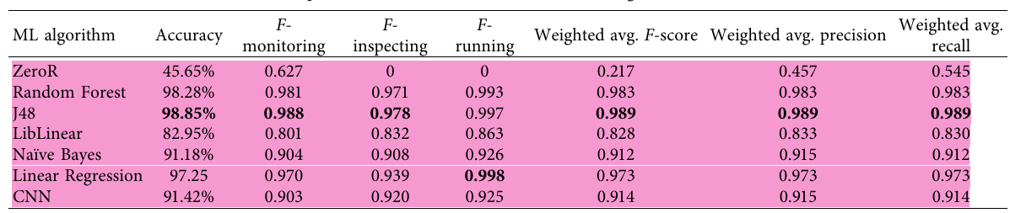
Performance of Machine Learning Algorithms
Eshrag A. Refaee et.al. Presented models achievedthehighestperformanceatan accuracyscoreof98.85%and0.98 weighted F-score using theJ48modeltrained onapubliclyavailable datasetof 874instances collected from 26differentsites across Saudi.

Slide 5
Role of Deep Learning Models
Veerapandiyan Veerasamy et.al. Presented Deep learning methods such as CNN and LSTM also exhibit strong performance. The proposed LSTM classifier achieved an overall classification accuracy of 91.21% with a success rate of 92.42% in identifying high impedance faults (HIF). The robustness of the LSTM model is validated through high kappa statistics, precision, recall, and F-measure scores, making it a reliable choice for dynamic fault detection. [2]

Slide 6
Impact of Data Granularity
Radu Platon et.al. highlights the significance of temporal granularity in achieving a high fault-detection accuracy. Models trained on hourly average data outperform those using 10 minute intervals, indicating that reducing noise in the data improves detection rates. Additionally, segmenting the data based on irradiance intervals led to detection rates exceeding 90%, further validating this approach.[3]

Slide 7
(Objective) System Optimization Through Innovation
Improved reliability of PV systems.
Faster detection and resolution of faults.
Reduction in operational disruptions.
Lower maintenance costs through automation and prediction.

Slide 8
Leveraging Data Analytics and Machine Learning
Use of high-frequency operational data for fault detection.
Machine Learning Advantages:
Predictive models for early fault detection.
Real-time analysis to identify fault patterns.
Classification of system states for enhanced monitoring.

Slide 9
Data collection
Data was collected from a rooftop PV system installed at an educational institute, with a 40 kWp PV array integrated with battery storage and grid support. The dataset spans May 2022 to May 2023 and includes measurements taken at 10-minute intervals,
Data Analysis
In our data analysis, we aim to comprehensively evaluate the performance and behavior of the solar energy system over the course of a year, focusing on the following key aspects:
Energy Generation Analysis
Solar Irradiation Trends
Battery Import/Export Dynamics
Load vs. Solar Generation Performance

Slide 10
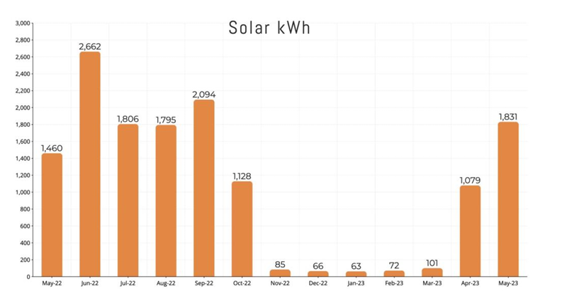
Monthly energy yield
Higher energy yields were observed in June and May, while February, March, July, and August also saw a larger share of energy production.
favorable conditions such as moderate cell temperatures (ranging from 27°C to 37°C) and cleaner modules in the later months compared to the earlier part of the year.

Slide 11
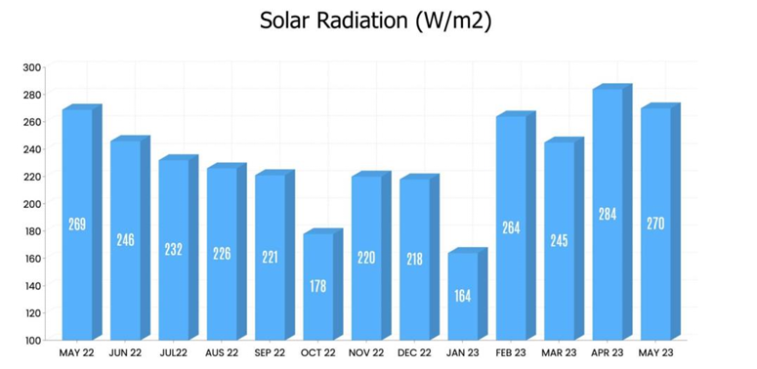
Monthly average solar irradiation

Slide 12
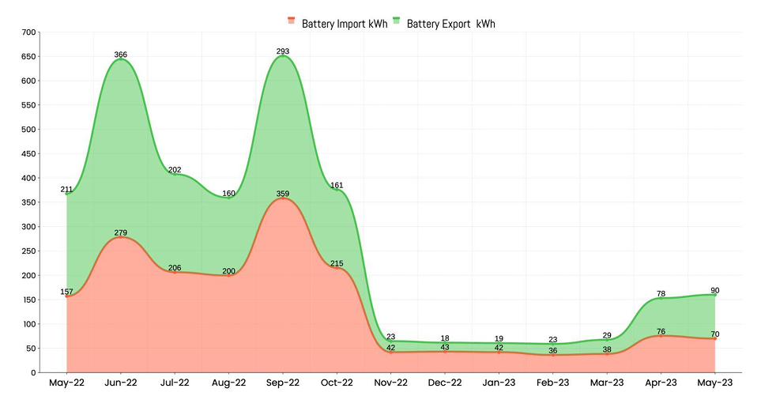
Monthly behavior of battery import/export.

Slide 13
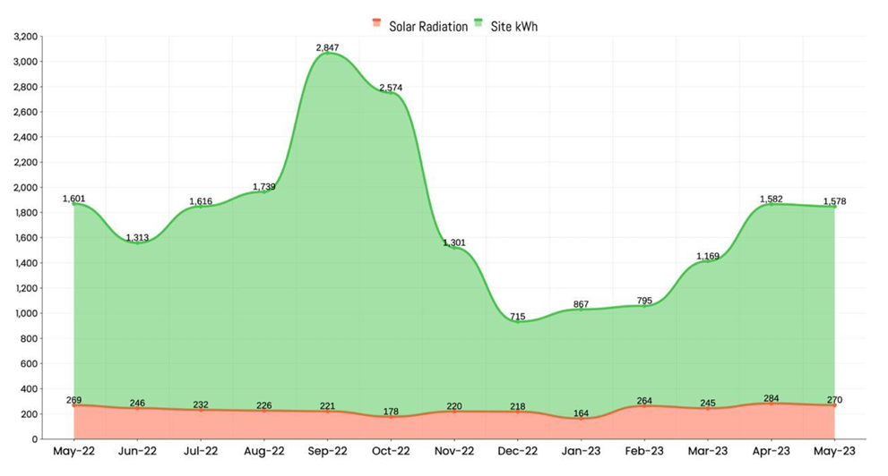
Monthly behavior of Solar radiation and Site

Slide 14
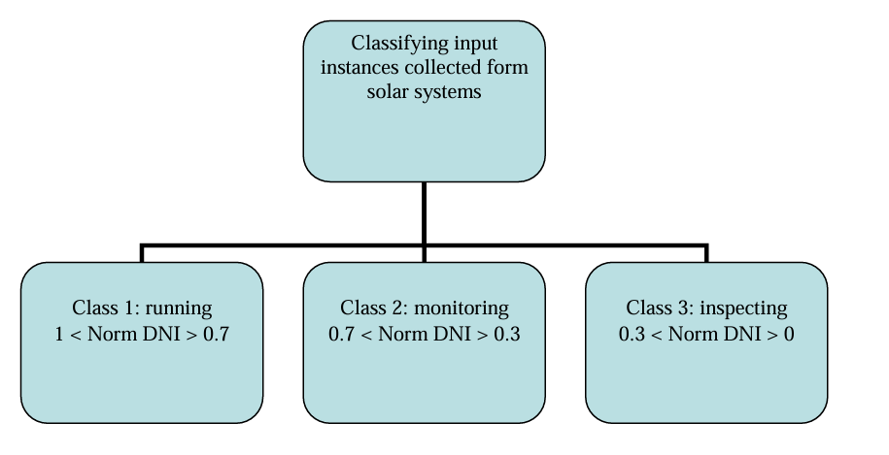
Classification Framework
Define operational classes based on normalized DNI values:
• Class 1 - Running (Green Zone): Normalized DNI (Norm DNI) > 0.7, indicating optimal solar system performance.
• Class 2 - Monitoring (Orange Zone): 0.3 ≤ Norm DNI ≤ 0.7, suggesting potential issues requiring closer observation.
• Class 3 - Inspecting (Red Zone): 0 ≤ Norm DNI < 0.3, signalling a need for immediate inspection due to underperformance.

Slide 15
Machine Learning Model Training and Integration
Data Preparation: Pre-process the dataset further to ensure it is fully optimized for training, including feature scaling, handling any remaining missing values, and creating a balanced dataset for all operational classes.
Model Training: Train a supervised learning model, incorporating historical data with operational states. Utilize features such as Direct Normal Irradiance (DNI), panel temperature, and the rate of change of DNI to achieve high prediction accuracy.

Slide 16
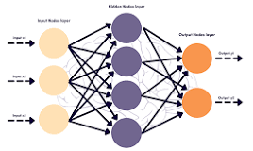
Machine Learning Model
ANN

Slide 17
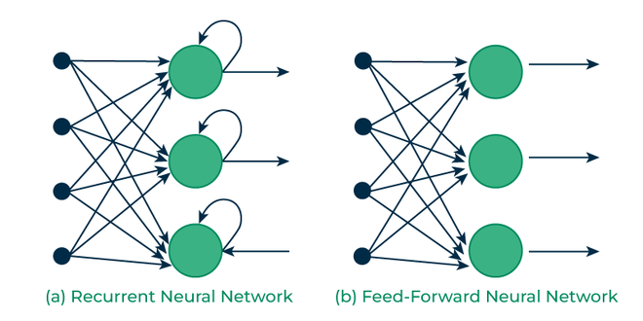
Machine Learning Model
RNN

Slide 18
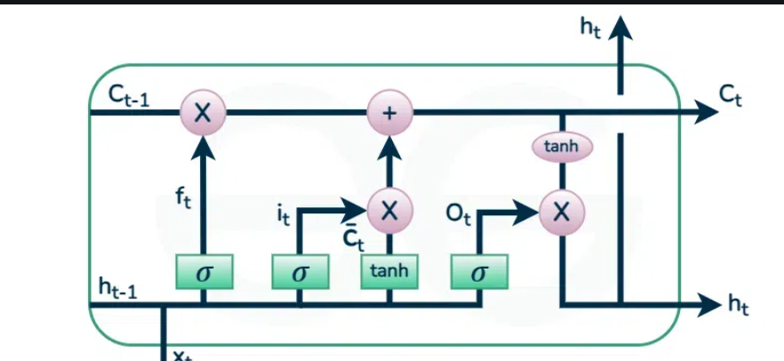
Machine Learning Model

